Slide 1

IS-201 - Database Part(1) of (2) Chapter - 2: Introduction to the Relational Model
DAW MAY THU KYAW
LECTURER
Faculty of Information Science

Slide 2
Outlines
Structure of Relational Databases
Database Schema
Keys
Schema Diagrams
Relational Query Languages

Slide 3

Resources
Textbook
Database System Concepts Seventh Edition, by Abraham Silberschatz Henry F. Korth and S. Sudarshan, 2020.
Content Creator:
Daw May Thu Kyaw, Lecturer, University of Computer Studies, Yangon

Slide 4
Structure of Relational Databases
A relational database consists of a collection of tables, each of which is assigned a unique name.
For example, Instructor table which stores information about instructors.
The tables has four column headers: ID, name, dept_name, salary.
Each row of this table records information about an instructor, consisting of the instructor’s ID, name, dept_name, salary.
Each instructor is identified by the value of the column ID.

Slide 5
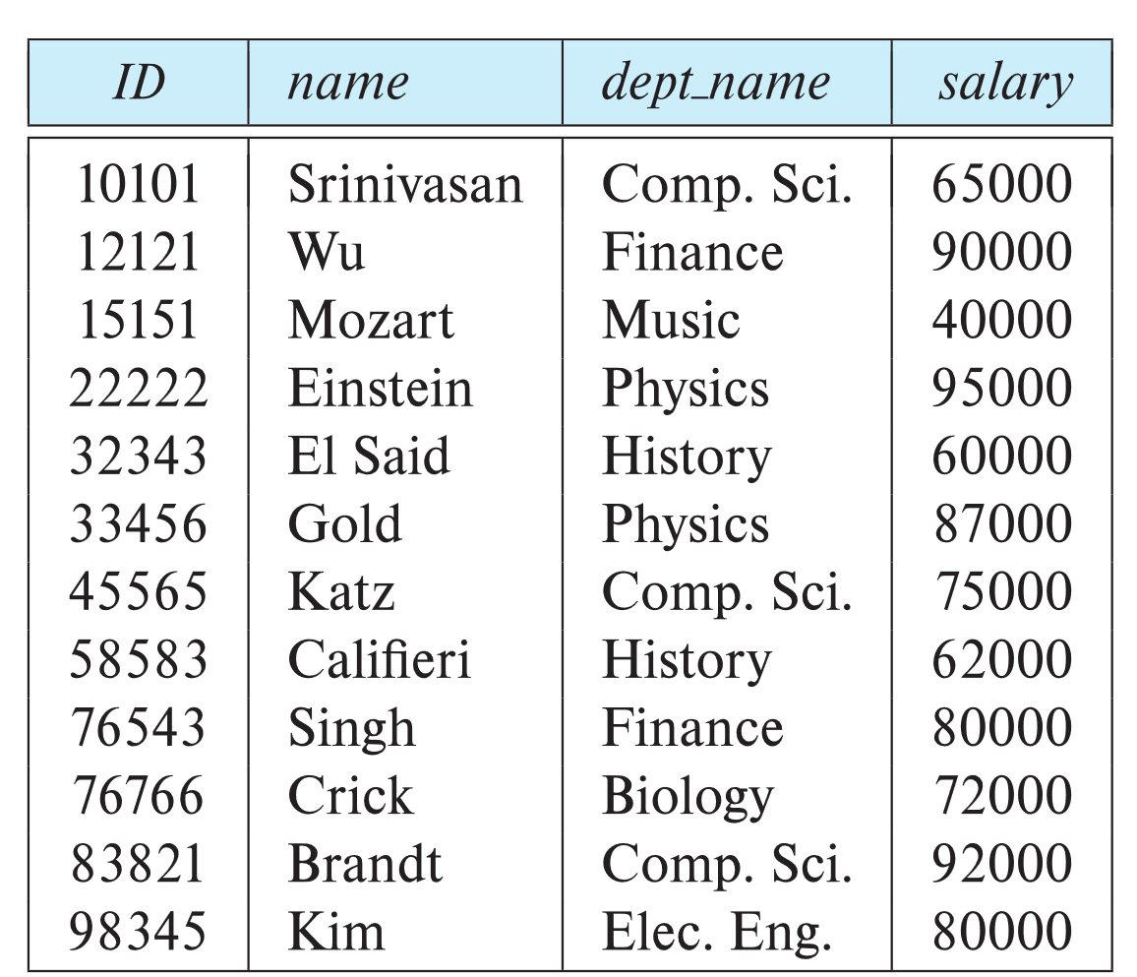
Example of a Instructor Relation
attributes
(or columns)
tuples
(or rows)

Slide 6
Example of a Instructor Relation
Course_id | title | Dept_name | credits
BIO-101 | Intro. To Biology | Biology | 4
BIO-301 | Genetics | Biology | 4
BIO-399 | Computational Biology | Bilogy | 3
CS-101 | Intro. To Computer Science | Comp. Sci. | 4
CS-190 | Game Design | Comp. Sci. | 4
CS-315 | Robotics | Comp. Sci. | 3
CS-319 | Image processing | Comp. Sci. | 3
CS-347 | Database System concepts | Comp. Sci. | 3
EE-181 | Intro. To Digital System | Elec. Eng. | 3
FIN-201 | Investment Banking | Finance | 3
HIS-351 | World History | History | 3
MU-199 | Music Video Production | Music | 3
Similarly, the course table stores information about courses, consisting of a course_id, title, dept_name, and credits, for each course.
Each course is identified by the value of the column course_id.

Slide 7
Example of a Instructor Relation
The third table, prereq, which stores the prerequisite course for each course. The table has two columns, course_id and prereq_id.
Each row consists of a pair of course identifiers such that the second course is a prerequisite for the first course.
Course_id | Prereq_id
BIO-301 | BIO-101
BIO-399 | BIO-101
CS-190 | CS-101
CS-315 | CS-101
CS-319 | CS-101
CS-347 | CS-101
EE-181 | PHY-101

Slide 8
Relation Schema and Instance
A1, A2, …, An are attributes
R = (A1, A2, …, An ) is a relation schema
Example:
instructor = (ID, name, dept_name, salary)
A relation instance r defined over schema R is denoted by r (R).
The current values a relation are specified by a table
An element t of relation r is called a tuple and is represented by a row in a table

Slide 9
Attributes
The set of allowed values for each attribute is called the domain of the attribute.
The domain of salary attribute of the instructor relation is the set of possible salary values, while the domain of the name attribute of the instructor relation is the set of possible instructor names.
Attribute values are (normally) required to be atomic; that is, indivisible units.
The special value null is a member of every domain. Indicated that the value is “unknown”.
The null value causes complications in the definition of many operations.

Slide 10
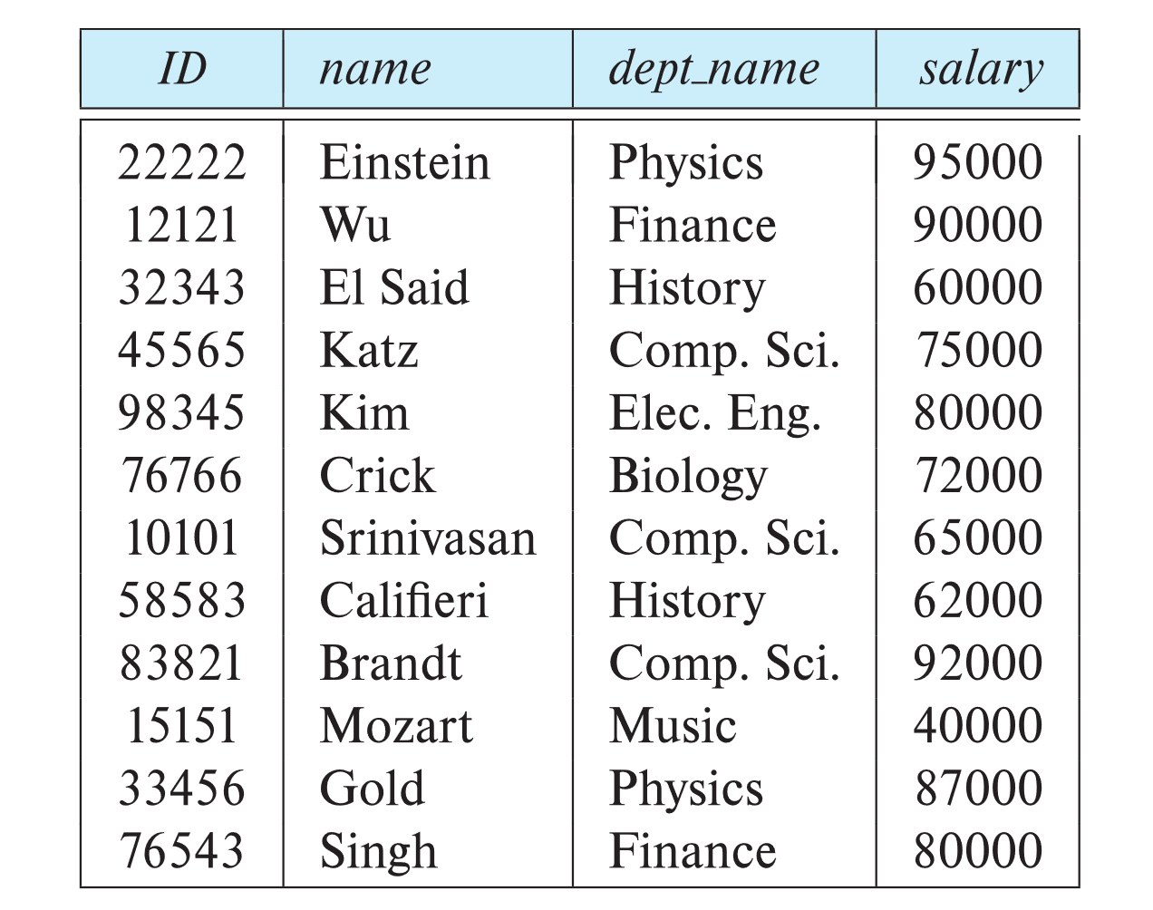
Relations are Unordered
Order of tuples is irrelevant (tuples may be stored in an arbitrary order)
Example: instructor relation with unordered tuples

Slide 11
Database Schema
Database schema -- is the logical structure of the database.
Database instance -- is a snapshot of the data in the database at a given instant in time.
Example:
schema: instructor (ID, name, dept_name, salary)
Instance:

Slide 12
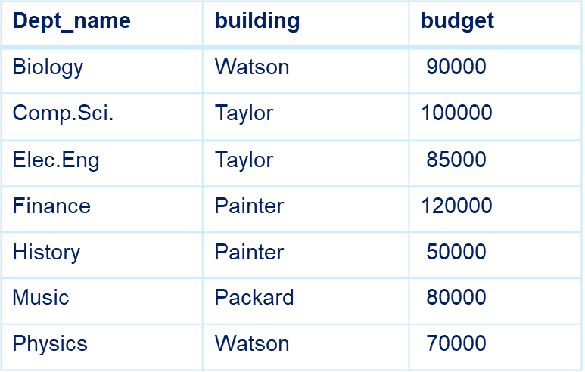
Database Schema
Consider the schema for the department relation.
department (dept_name, building, budget)
Dept_name appears in both the instructor schema and department schema. This duplication is not coincidence.

Slide 13
Keys
The values of the attributes values of a tuple must be such that they can uniquely identify the tuple. No two tuples in a relation are allowed to have exactly the same value for all attributes.
A superkey is a set of one or more attributes that, taken collectively, allow us to identify uniquely a tuple in the relations.
Let K ⊆ R
K is a superkey of R if values for K are sufficient to identify a unique tuple of each possible relation r(R)
Example: {ID} and {ID,name} are both superkeys of instructor.
A superkey may contain extraneous attributes. Such minimal superkeys are called Candidate keys.
Superkey K is a candidate key if K is minimal
Example: {ID} is a candidate key for Instructor

Slide 14
Primary Keys
One of the candidate keys is selected to be the primary key.
Primary keys are also referred to as primary key constraints.
Consider the classroom relation:
Classroom( building, room_number, capacity)
The primary key consists of two attributes.
Time_slot(time_slot_id, day, start_time, end_time)
Time_slot_id ‘A’ meet from 8:00 A.M. to 8:50 A.M on Mondays, Wednesdays, Fridays.
So the primary key consists of three attributes.

Slide 15
Foreign Keys
Instructor(ID, name, dept_name, salary)
Department(dept_name, building, budget)
Consider the attribute dept_name of instructor table and department table.
tuple a from the instructor relation
tuple b from the department relation
The value of dept_name attribute of tuple a is the same as the value of the primary key, dept_name of tuple b.
Foreign key constraint: Value in one relation must appear in another
Attribute set A is called a foreign key from r1, referencing r2. The relation r1 is also called a Referencing relation of the foreign key constraint, and r2 is called Referenced relation.
Example: dept_name in instructor is a foreign key from instructor referencing department

Slide 16
Schema of University database
Classroom (building, room_number, capacity)
Department(dept_name, building, budget)
Course(course_id, title, dept_name, credits)
Instructor(ID, name, dept_name, salary)
Section(course_id, sec_id, semester, year, building, room_number, time_slot_id)
Teaches(ID, course_id, sec_id, semester, year)
Sutdent (ID, name, dept_name, tot_cred)
Takes(ID, course_id, sec_id, semester, year, grade)
Advisor(s_ID, i_ID)
Time_slot(time_slot_id, day, start_time, end_time)
Prereq(course_id, prereq_id)
A database schema, along with primary key and foreign key constraints, can be depicted by schema diagrams.

Slide 17
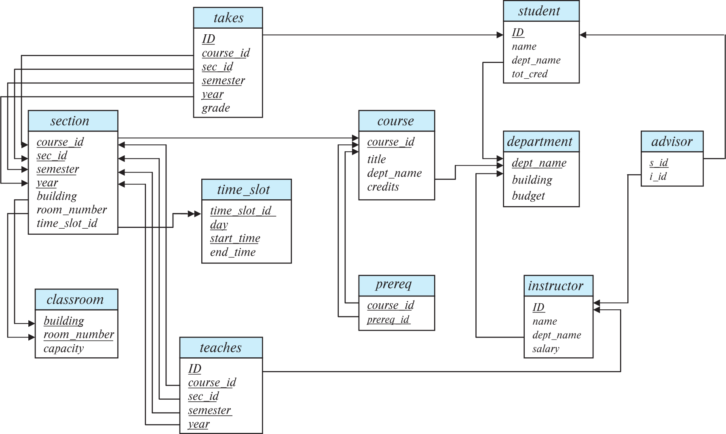
Schema Diagram for University Database

Slide 18
Schema diagram
Figure shows the schema diagram for university organization. Each relation appears as a box, with the relation name at the top in blue and the attributes listed inside the box.
Primary key attributes are shown underlined.
Foreign key constraints appear as arrows for the foreign key attributes of the referencing relation to the primary key or the referenced relation.
Use two-headed arrow, instead of a single-headed arrow, to indicate a referential integrity constraint that is not a foreign-key constraints.
In Figure, the line with two-headed arrow from time_slot_id in the section relation to time_slot_id in the time_slot relation represents the referential integrity constraint from section.time_slot_id to time_slot.time_slot_id.

Slide 19
Relational Query Languages
A query language is a language in which a user requests information from the database.
Query languages can be categorized as imperative, functional, or declarative.
In an imperative query language, the user instructs the system to perform a specific sequence of operations on the database to compute the desired result.
In a functional query language, the computation is expressed as the evaluation of functions that may operate on data in the database or on the results of other functions.
In a declarative query language, the user describes the desired information without giving a specific sequence of steps or function calls for obtaining that information.

Slide 20
Relational Query Languages
“Pure” languages:
Relational algebra
Tuple relational calculus
Domain relational calculus
The above 3 pure languages are equivalent in computing power
We will concentrate in this chapter on relational algebra
Not Turing-machine equivalent
Consists of 6 basic operations

Slide 21
Next Lecture
The Relational Algebra _ will be explained.

